Slide 1
420-D04-SU
Object-oriented programming I Java I
Swing 2: Menus / Dialog boxes

Slide 2
Dialog boxes
Dialog boxes are small windows that can:
Display information (error, warning, notification, …)
Ask the user to confirm or cancel an operation
Ask the user for some information

Slide 3
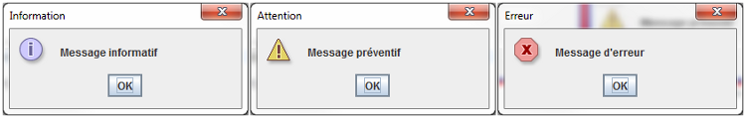
Information dialog boxes
JOptionPane, a modal dialog box, shows a message to the user.
It is modal because it blocks access to the parent application until the user has handled and closed the dialog box.
JOptionPane.showMessageDialog(
null,
"oh no an error", //message
"Error", //title
JOptionPane.ERROR_MESSAGE);

Slide 4
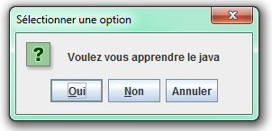
Confirmation dialog boxes
Asks the user to confirm an action.
Possible option types:
Yes / No
Yes / No / Cancel
OK / Cancel
int reponse = JOptionPane.showConfirmDialog(
null, "Do you want to learn Java?");
if(reponse == JOptionPane.OK_OPTION){
System.out.println("Java is fun.");
}else if (reponse == JOptionPane.NO_OPTION){
System.out.println("Are you sure?");
}else if (reponse == JOptionPane.OK_CANCEL_OPTION){
System.out.println("You can answer later.");
}

Slide 5
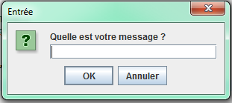
Input dialog boxes
Asks to user to input some information.
String message = JOptionPane.showInputDialog( null, "What is your message?");
System.out.println(message);

Slide 6
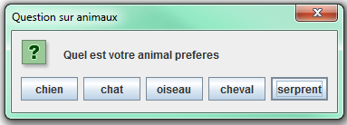
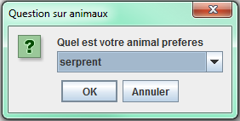
Option dialog boxes
2 possible techniques:
String[] choices = { "dog", "cat", "bird", "horse", "snake" };
int response = JOptionPane.showOptionDialog( null, "What is your favorite animal", "Animal question", 0, JOptionPane.QUESTION_MESSAGE, null, choices, choices[4]);
System.out.println(choice[response]);
String name = (String) JOptionPane.showInputDialog( null, "What is your favorite animal", "Animal question", JOptionPane.QUESTION_MESSAGE, null, choices, choices[4]);
System.out.println(name);

Slide 7
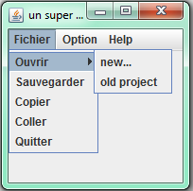
Menus: JMenuBar
JFrame
setJMenuBar(JMenuBar bar)
JMenuBar
add(JMenu menu)
JMenu
add(JMenuItem item)
addActionListener(ActionListener l) (explained when we study events)
JMenuItem
addActionListener(ActionListener l) (explained when we study events)

Slide 8
Tabs: JTabbedPane
JPanel pan1 = new JPanel();
JPanel pan2 = new JPanel();
pan1.setBackground(Color.RED);
pan2.setBackground(Color.BLUE);
JTabbedPane tabs = new JTabbedPane();
tabs.add("Tab 1", pan1);
tabs.add("Tab 2", pan2);
setContentPane(tabs);
Can set the tab placement (top / bottom / left / right):
JTabbedPane tabs = new JTabbedPane(JTabbedPane.RIGHT);

